Slide 1
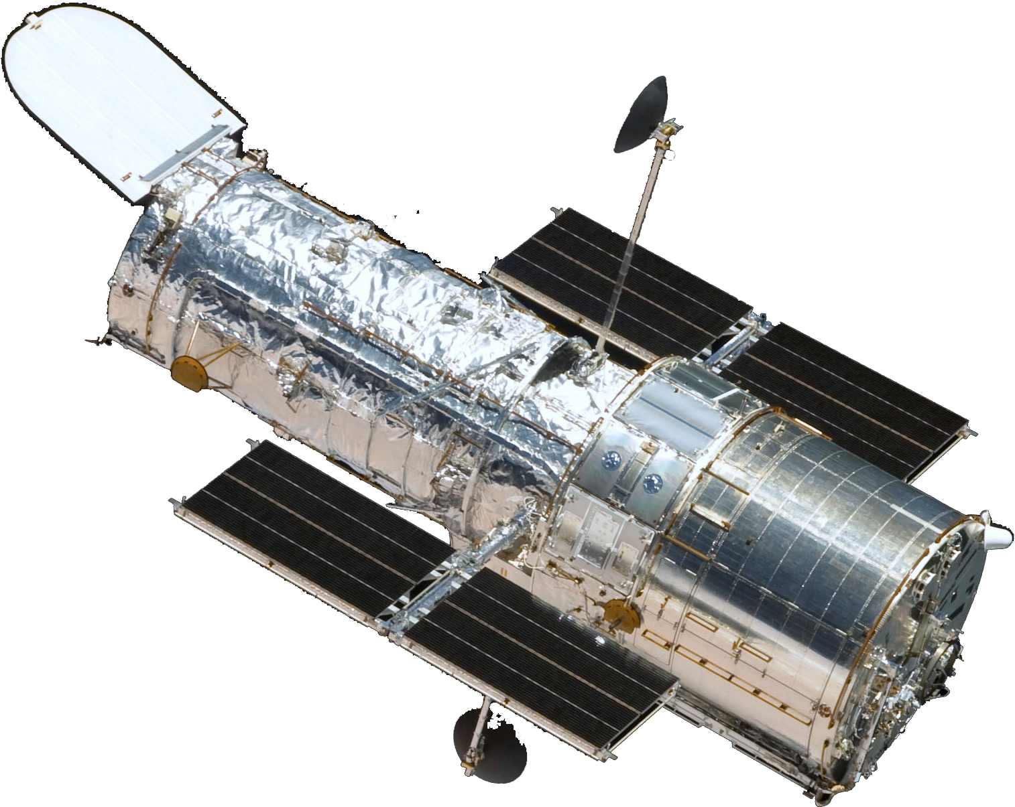

Geophysics using the Hubble Space Telescope or Using the garbage of the HST
Gonzalo Tancredi¹, Germán Schnyder², Sergio Nesmachnow², Susana Deustua³
1 - Depto. Astronomía, Fac. Ciencias, UdelaR, URUGUAY
2 - Inst. Computación, Fac. Ingeniería, UdelaR, URUGUAY
3 - Space Telescope Science Institute, USA

Slide 2
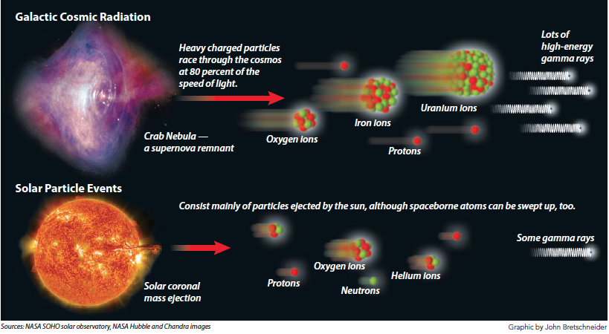
Cosmic rays = Galactic cosmic particles + Solar Energetic Particles

Slide 3
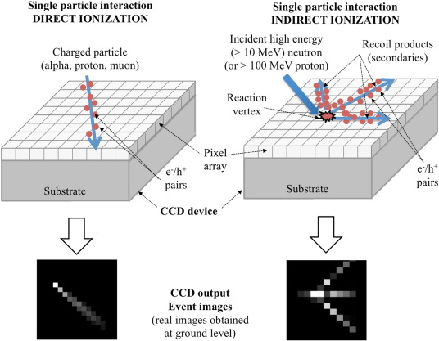
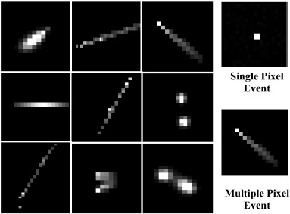
Cosmic rays in astronomical images
Taken from Saoud et al. (2016)
Indirect ionization is of concern for atmospheric neutrons and high-energy protons (>100 MeV) that are able to ionize by collision with the target nuclei. Neutrons ionize indirectly, they do not interact via the Coulomb force, and so they can travel through several centimeters of material without interacting with other particles and can remain undetected with CCD.
Direct ionization is achieved through Coulomb interactions between a charged particle and atoms of the device. The charged particle strips electrons of atoms as it passes through the device thereby causing ionizations. Heavy ions, low energy protons and muons directly ionize matter.

Slide 4
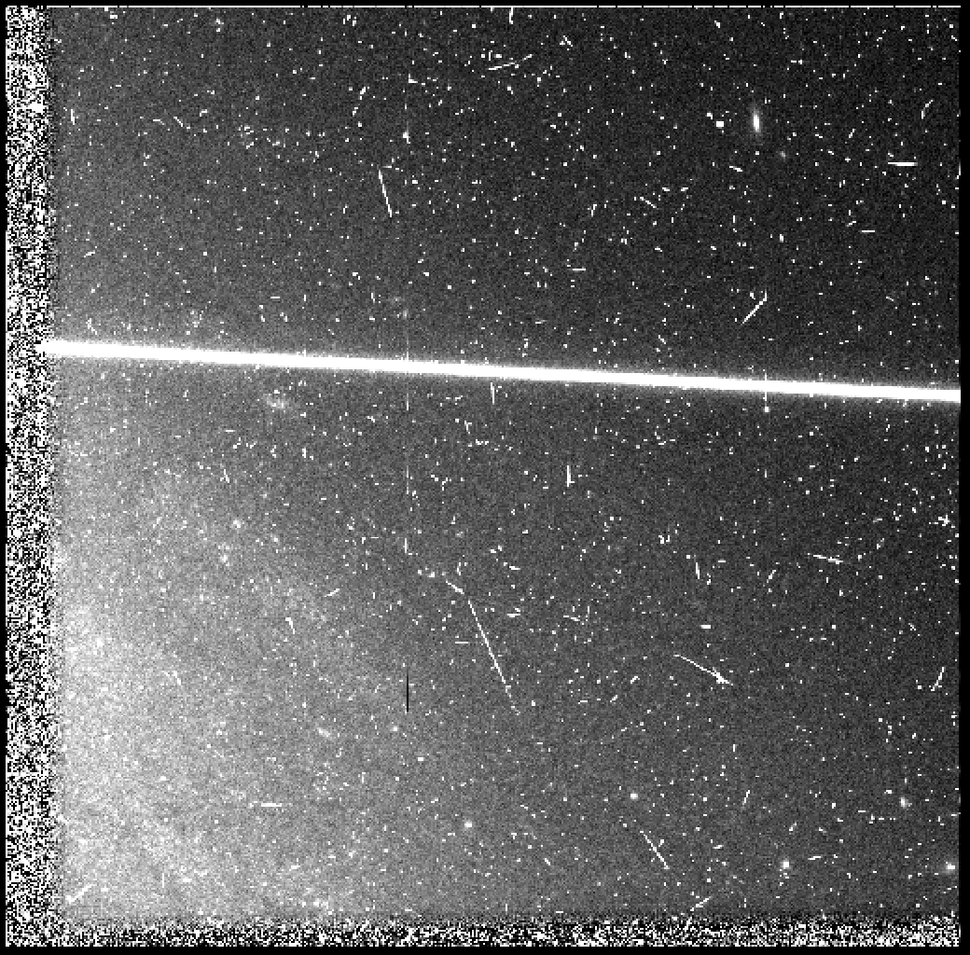
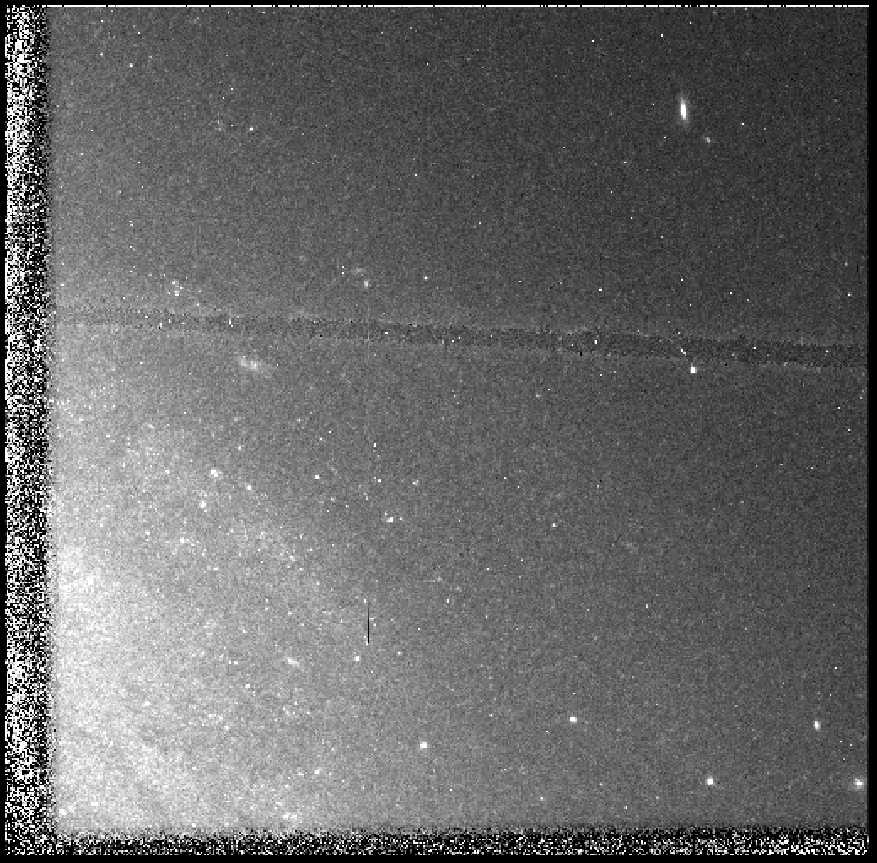
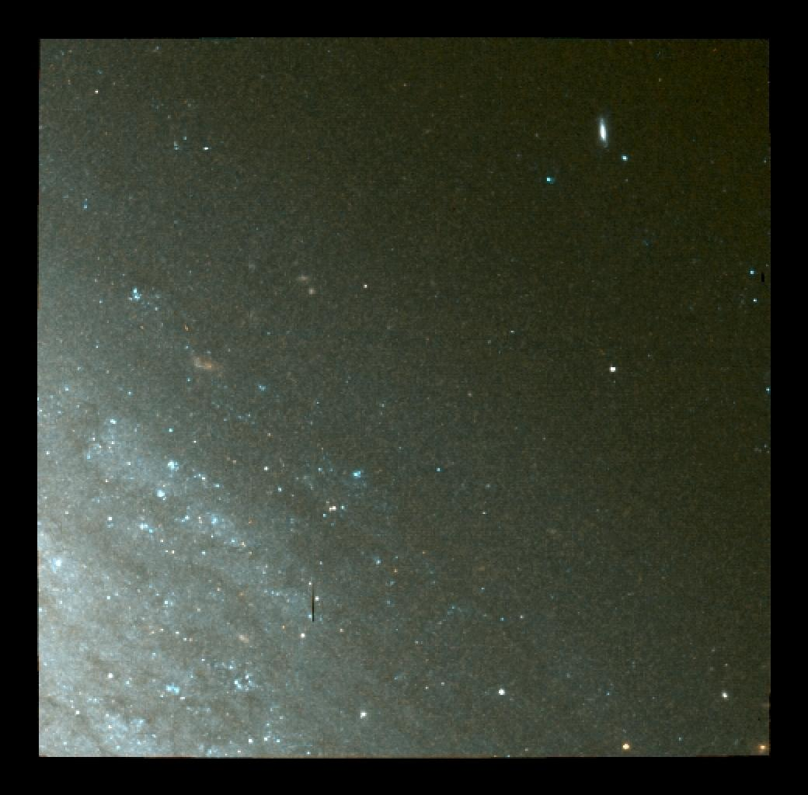
Cosmic rays in HST images

Slide 5
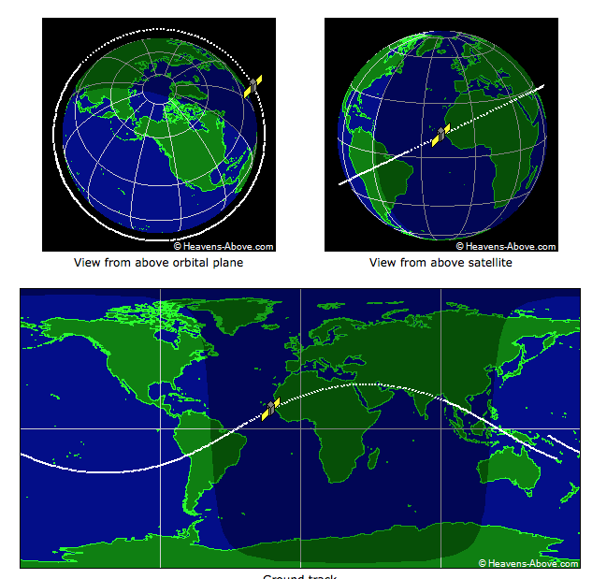
HST orbit
Regime Low Earth
Semi-major axis 6,919 km
Eccentricity 0.000283
Perigee 539 km
Apogee 543 km
Inclination 28.47°
Period 95.47 minutes
Mean motion 15.08 rev/day
Velocity 7.59 km/s
A unique CR detector at 500km above the surface in operation for 25yr (2 solar cycles).

Slide 6
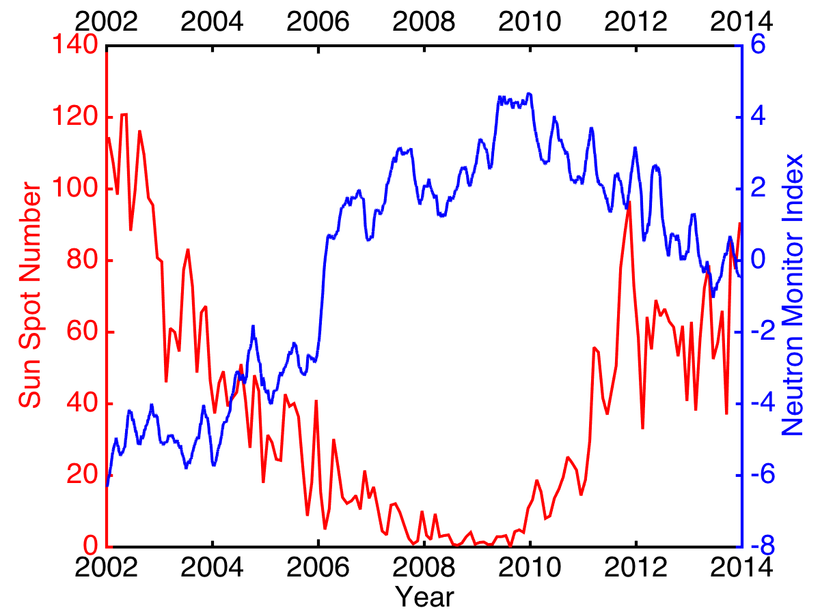
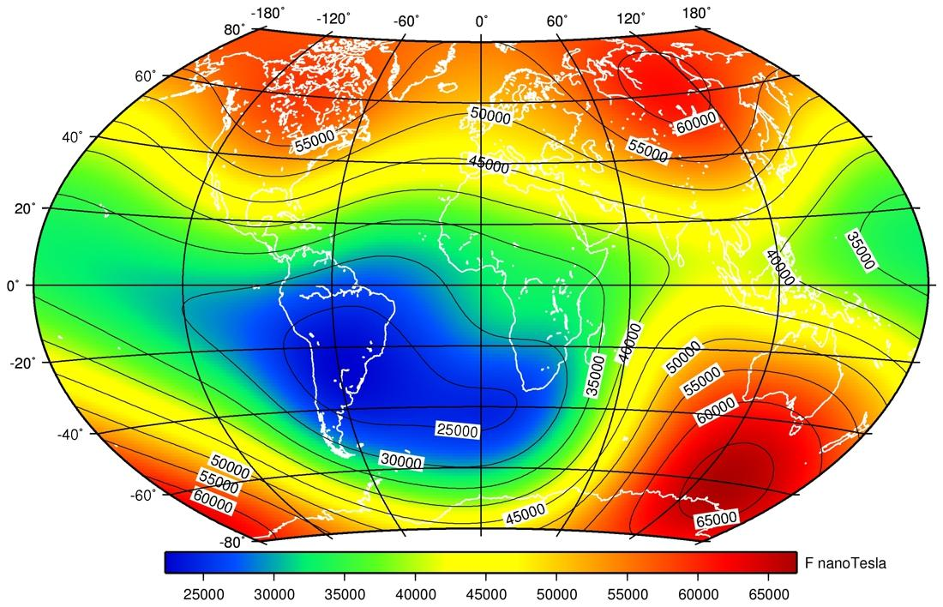
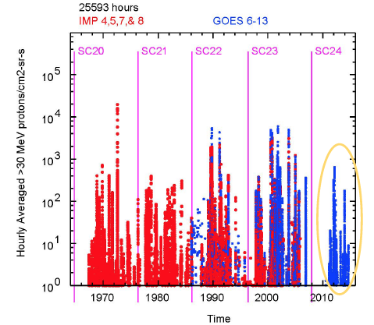
A variable environment in space and time
World Magnetic Model (WMM)
by British Geological Survey (2015)
SEP events detected by GOES (Tylka, 2015)

Slide 7
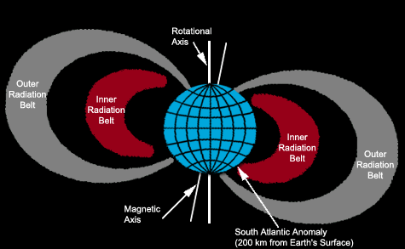
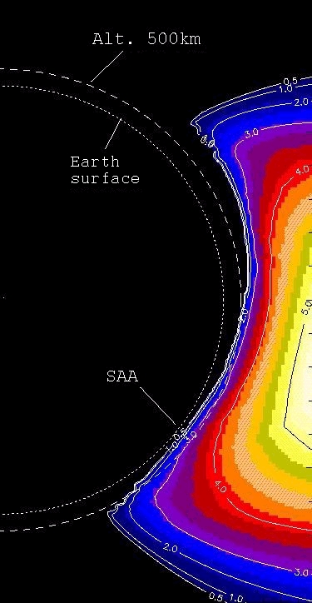
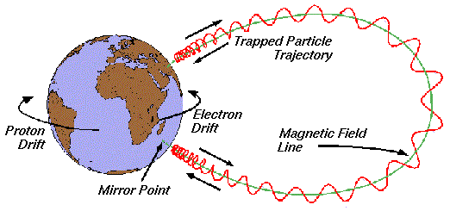
Van Allen radiation belts & SAMA
The proton raddiation belt comes to a distance of 500 km above the surface in the SAMA region; just the orbital distance of HST.

Slide 8
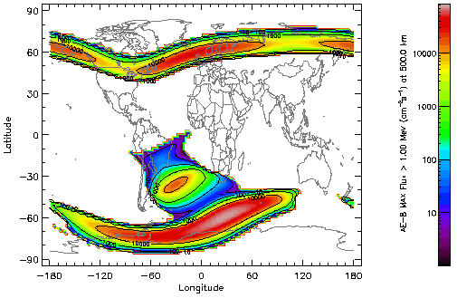
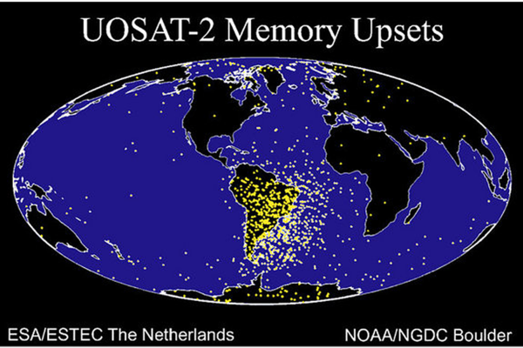
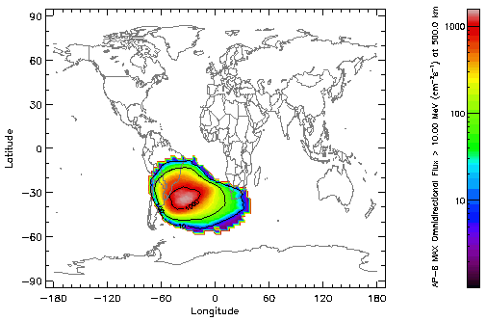
Consequences of Energetic particles at 500km
e⁻ flux @ 500km
p⁺ flux @ 500km

Slide 9
Project: Geophysics using Hubble Space Telescope
We propose to use the entire data set of DARK images taken by the HST during its >25 yr of operations to monitor the “Cosmic Rays” (CR) flux as a function of:
Time
Location of the spacecraft
The proposal was approved by the STScI for the Hubble Space Telescope Cycle 24 Archival run (06/2016).
We got ~130.000 dark frames from 5 different instruments (7 detectors).
~ 15 TB of data
~15000 hr of observation during ~ 22yr

Slide 10
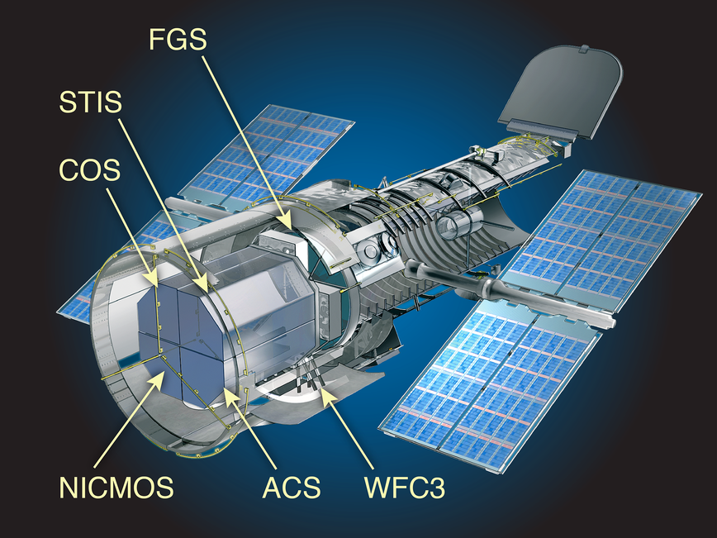
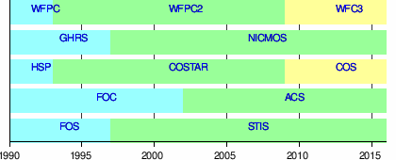
Instruments
Years of operation for each instrument
Instrument | Detector | Number | Type | # pixels x | # pixels y | size pixel 𝜇m) | size pixel 𝜇m) | Area (mm²)
WFPC2 |  | 4 | CCD | 800 | 800 | 15 | 15 | 144
STIS |  | 1 | CCD | 1024 | 1024 | 21 | 21 | 462
NICMOS |  | 3 | HgCdTe | 256 | 256 | 40 | 40 | 105
ACS | HRC | 1 | CCD | 1024 | 1024 | 21 | 21 | 462
ACS | WFC | 2 | CCD | 4096 | 2048 | 15 | 15 | 1887
WFC3 | UV | 2 | CCD | 4096 | 2051 | 15 | 15 | 1890
WFC3 | IR | 1 | HgCdTe | 1014 | 1014 | 18 | 18 | 333

Slide 11


Dark images
A dark frame is an image captured with the sensor in the dark, with the shutter on and for a long exposure time. A significant amount of charge can accumulate in the CCD pixels due to thermal excitation. Astronomers overcome the problem of dark charge by cooling the CCDs. Nevertheless, there are pixels (or group of pixels) with values with large dispersion compared to the rest: hot and cold pixels. All cold pixels and some hot ones are caused by physical defects. They do not change in position with time (almost).
Pixels with high values that change from frame to frame are cosmic rays impacts.

Slide 12
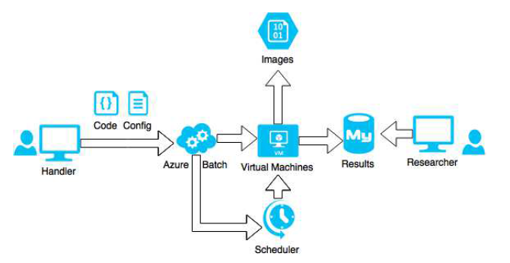
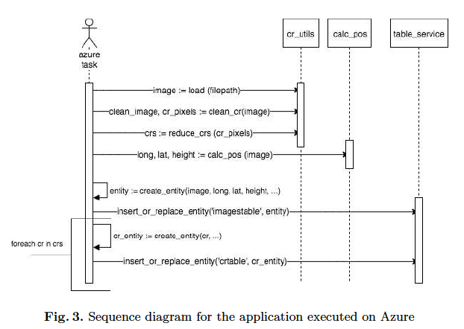
Processing pipeline
Image processing is performed on virtual machines from the Microsoft Azure cloud platform using a developed Python application.
For the CR detection, we use a python version of L.A. Cosmic algorithm (van Dokkum, 2001; cosmic.py - Tewes, 2010).

Slide 13
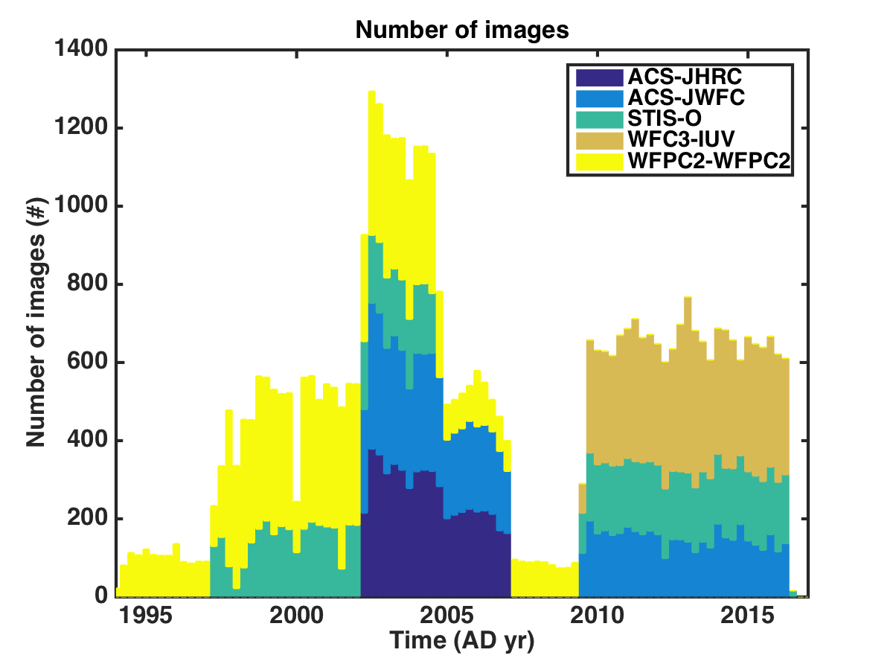
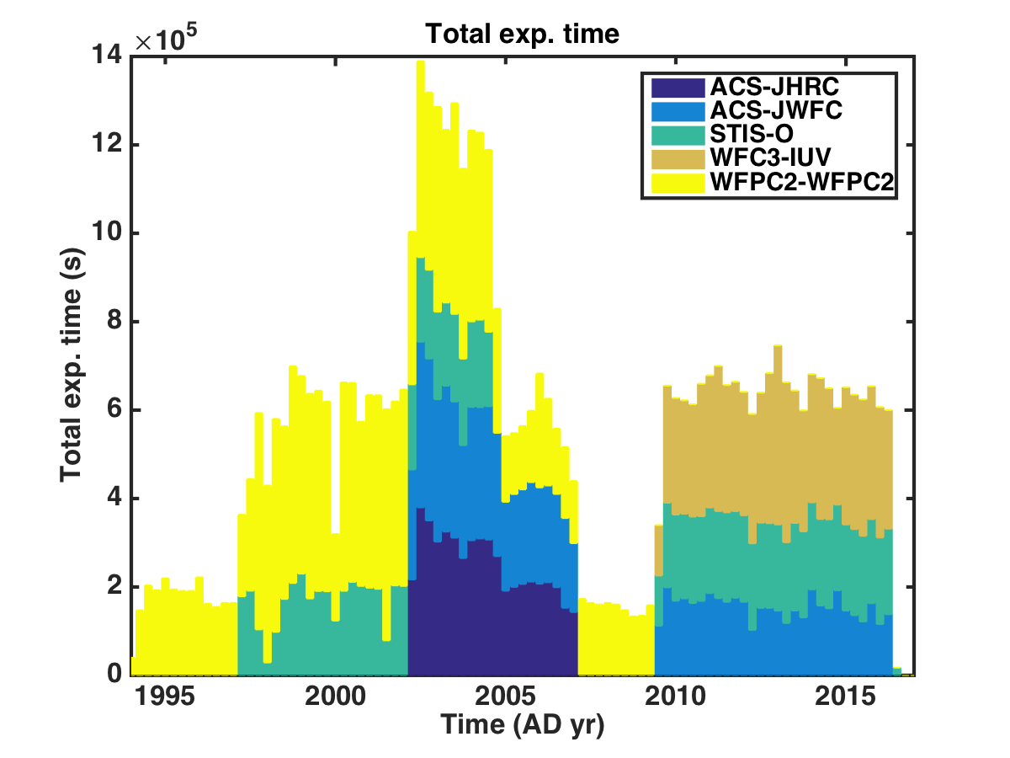
Time coverage of CCD instruments

Slide 14
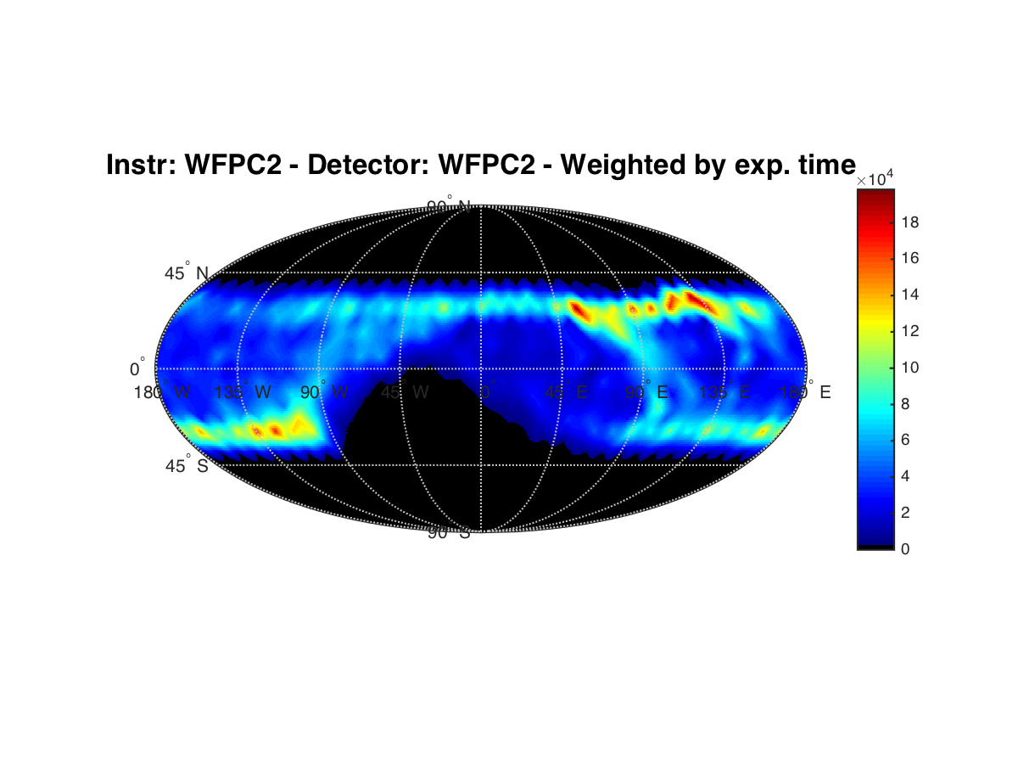
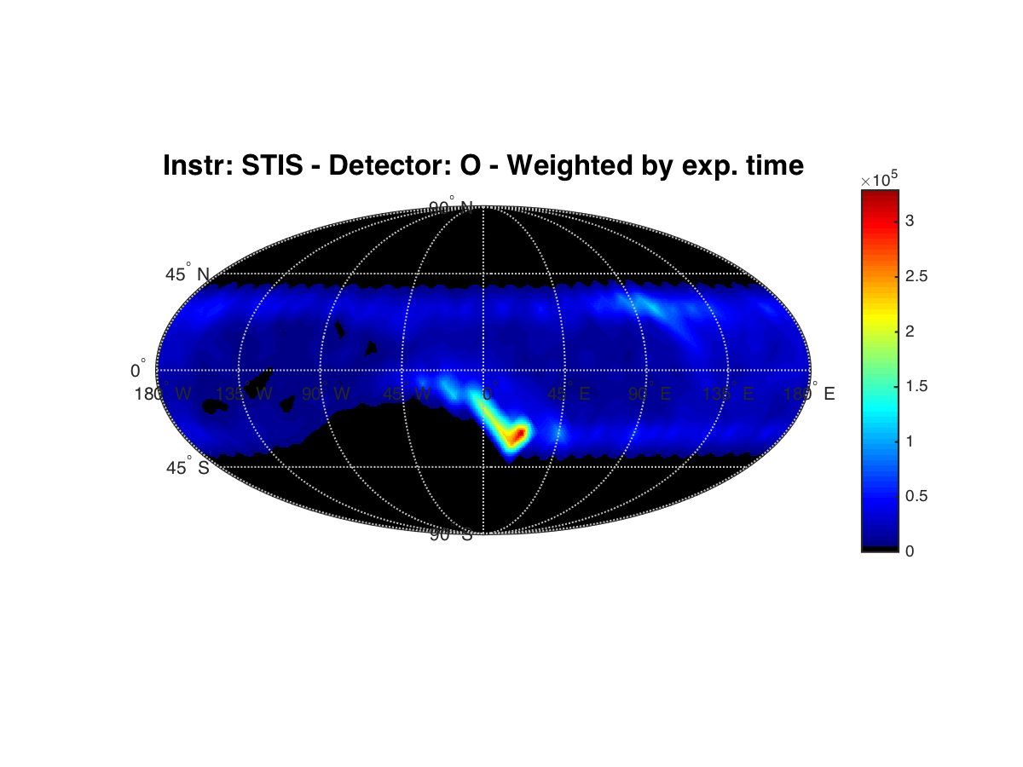
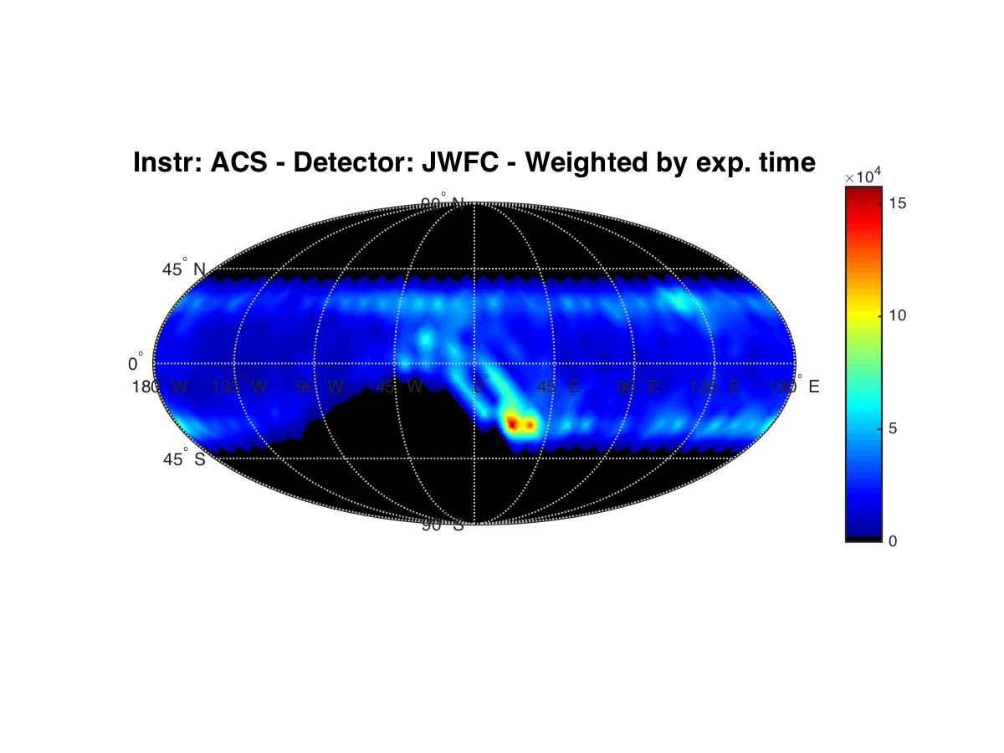
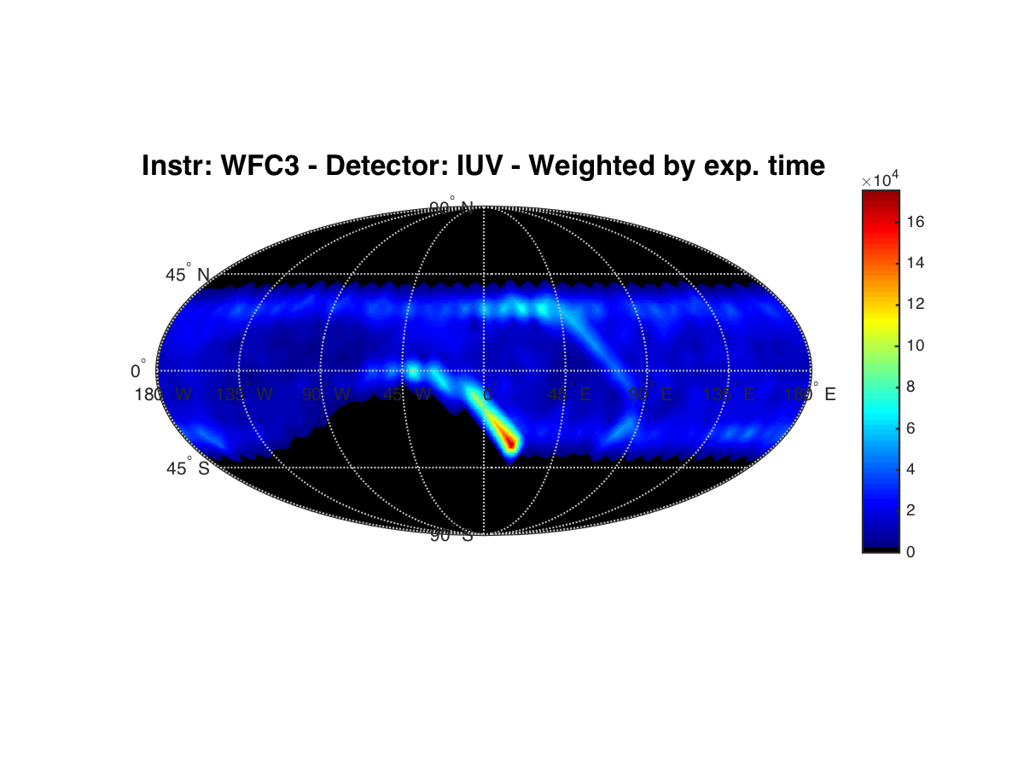
Geographic coverage

Slide 15
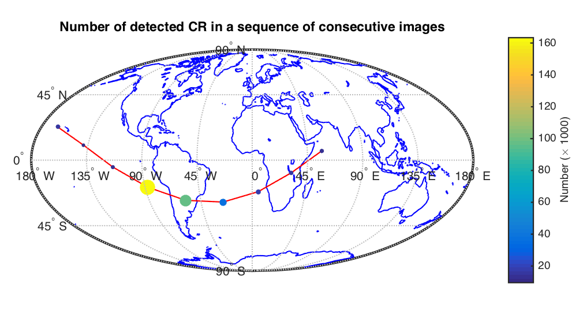
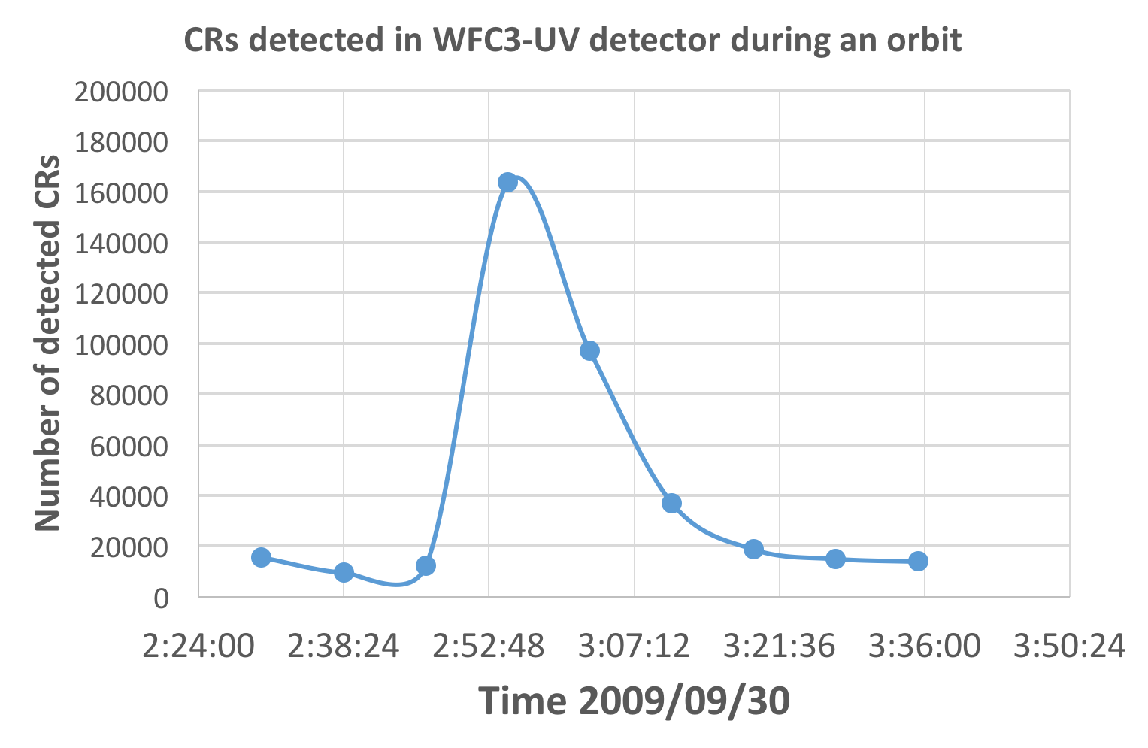
A sharp increase in the #CRs while crossing the SAMA
The dots mark the HST position at the start of the 360s exposure.
The color and size of the dots are proportional to the number of detected CRs.

Slide 16
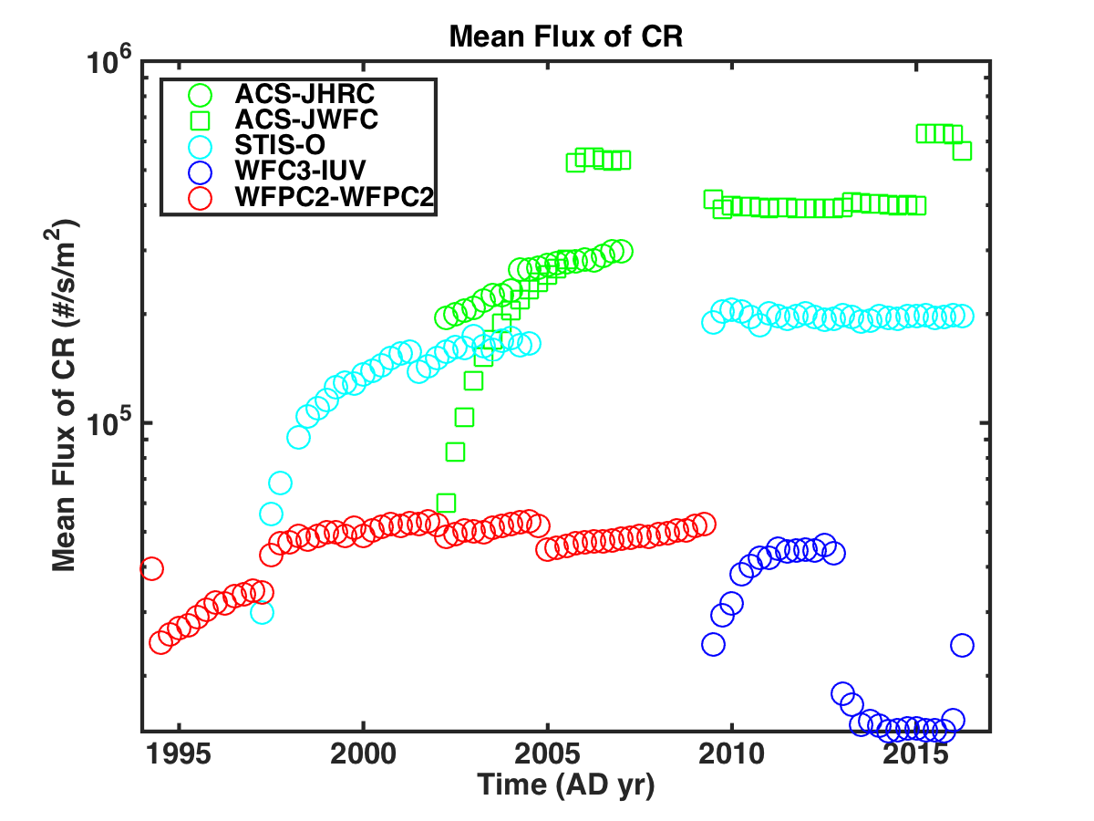
Time evolution of the CR flux

Slide 17
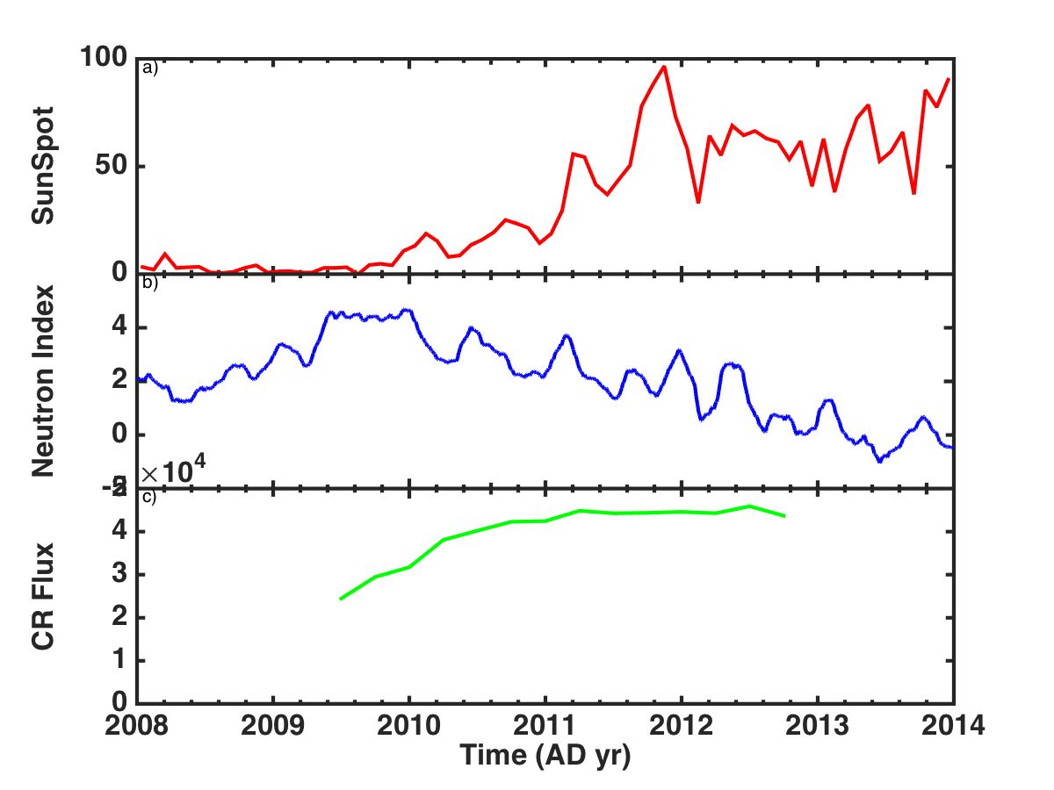
A possible correlation
Neutron Monitor Index @ surface
CR flux from images of WFC3 - UV

Slide 18
Preliminary conclusions
We have access to ~130.000 dark frames from 5 different instruments, corresponding to 15000 hr of observation along ~ 22yr
Large increment of the CR flux for a factor > 10 was detected during passages in the SAMA region.
VERY PRELIMINARY: The CR flux @ 500 km correlates with solar activity, but has opposite correlation with the CR flux on the surface, measured by the neutron stations.

Slide 19
Future works
Compare CR detection algorithms
Include IR detectors in the analysis
Include new instruments (WFPC1, FOC, FOS, …)
Correlate fluxes with:
Solar activity
CR detector on the surface (e.g. muon detectors)
Extend the analysis to the complete HST data sets: 100k hr and over 1M images.

Slide 20
Acknowledgements:
Space Telescope Science Institute for providing access to the HST archive
Microsoft Azure Platform for allocating computer time and storage
UN/OOSA, Boston College, ISWI, … for supporting my participation at the Workshop

